Slide 1
Spring
PRIYANKA SARODE

Slide 2
Index
What is Spring?
History and Origin
Features of Spring
Why Spring?
Benefits
Architecture
IoC(Inversion Control)
Bean Factory and Application Context
Dependency Injection
Advantages

Slide 3
What is Spring?
Spring Framework is a powerful lightweight application development framework used for Enterprise Java (JEE).
The core features of the Spring Framework can be used in developing any Java application.
It can be described as complete and modular framework.
The Spring Framework can be used for all layer implementations of a real time application.
It can also be used for the development of particular layer of a real time application unlike Struts and Hibernate, but with Spring we can develop all layers.

Slide 4
History and Origin
Version | Date | Notes
0.9 | 2003
1.0 | March 24, 2004 | First production release.
2.0 | 2006
3.0 | 2009
4.0 | 2013
5.0 | 2017
The first version was written by Rod Johnson, who released the framework with the publication of his book Expert One-on-One J2EE Design and Development in October 2002. The framework was first released under the Apache 2.0 license in June 2003.
Roderick B. Johnson, an Australian computer specialist officially released the Spring Framework in 2004. Since its origin, the Spring Framework has released many versions.
The current stable version, as of March 2022, is Spring 5.3.16.

Slide 5
Features Of Spring Framework
Lightweight: Spring Framework is lightweight with respect to size and transparency.
Inversion Of Control (IoC): In Spring Framework, loose coupling is achieved using Inversion of Control. The objects give their own dependencies instead of creating or looking for dependent objects.
Aspect Oriented Programming (AOP): By separating application business logic from system services, Spring Framework supports Aspect Oriented Programming and enables cohesive development.
Container: Spring Framework creates and manages the life cycle and configuration of application objects.
MVC Framework: Spring Framework is a MVC web application framework. This framework is configurable via interfaces and accommodates multiple view technologies.
Transaction Management: For transaction management, Spring framework provides a generic abstraction layer. It is not tied to J2EE environments and it can be used in container-less environments.
JDBC Exception Handling: The JDBC abstraction layer of the Spring Framework offers an exception hierarchy, which simplifies the error handling strategy.

Slide 6
Why Spring?
Works on POJOs (Plain Old Java Object) which makes your application lightweight.
Provides predefined templates for JDBC, Hibernate, JPA etc., thus reducing your effort of writing too much code.
Because of dependency injection feature, your code becomes loosely coupled.
Using Spring Framework, the development of Java Enterprise Edition (JEE) applications became faster.
It also provides strong abstraction to Java Enterprise Edition (JEE) specifications.
It provides declarative support for transactions, validation, caching and formatting.

Slide 7
Practical Demo
Simple Mobile Application Using Spring

Slide 8
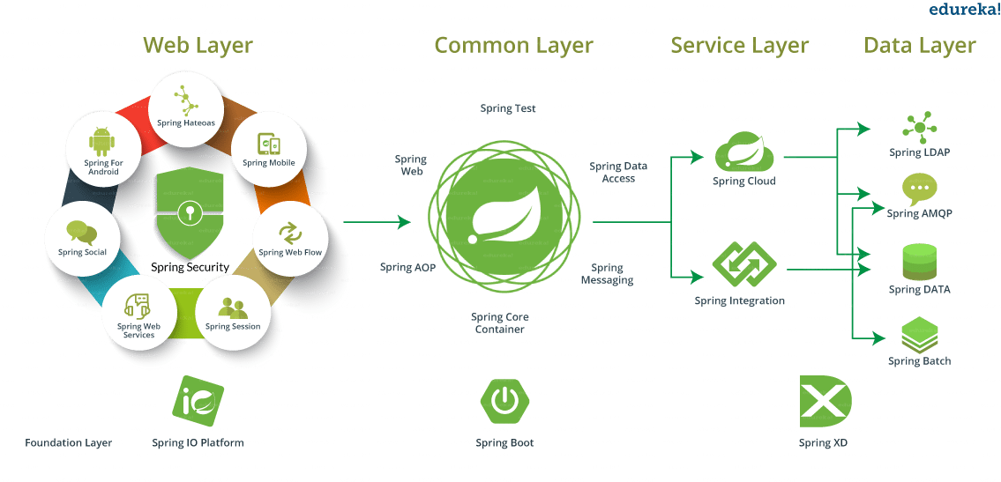
Spring Framework

Slide 9
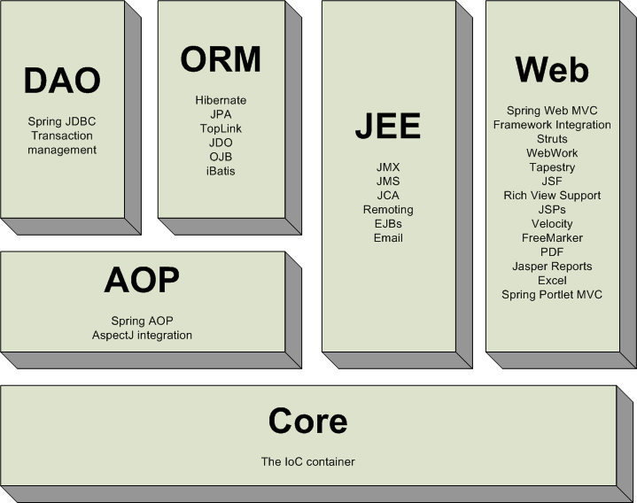
Spring Architecture
https://docs.spring.io/spring-framework/docs/2.5.x/reference/images/spring-overview.png

Slide 10
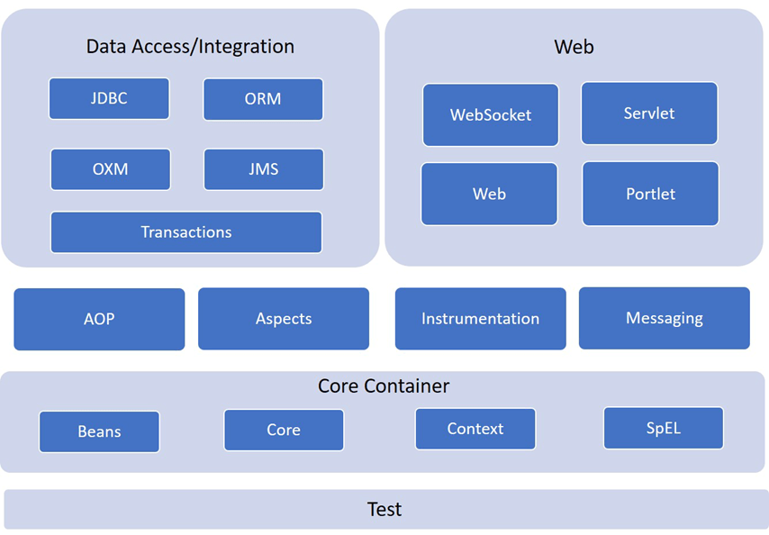
Spring Framework Architecture

Slide 11
Spring Modules
Spring Core Module: The Spring Core module is the core component of the Spring Framework providing the IoC container. In this module, the objects are expressed for the composition of the application and the interdependencies between application objects are removed.
Spring AOP Module: The Spring AOP module is analogous to Object-Oriented Programming. OOPs, concepts break down the application into a hierarchy of objects and AOP breaks down the program into aspects or concerns. Aspects are nothing but a technique to modularize concerns and concerns are like transactions/logging/security that cuts across a lot of objects.
ORM Module: The ORM module helps in accessing data from the databases.
Spring Web MVC Module: It helps Spring in implementing MVC architecture for the creation of web applications as it separates the model and views components of the code.
Spring Web Flow: The Spring Web Flow is just an extension of the Spring Web MVC module where it helps in defining the XML file or the Java class that manages the workflow between different UI pages.
Spring DAO: The Spring DAO package provides data access technologies like JDBC, Hibernate.
Spring Context Module: The Spring Context module is the interface of the BeanFactory and supports functionalities like internationalization, validation, event propagation, and resource loading

Slide 12
Benefits
Open Source
Light Weight
Inversion Of Control
Dependency Injection
Data Access
Easy to Test
Web MVC
AOP
Enterprise Application
Fast development
Powerful abstraction

Slide 13
Back to Practical Example
Simple Mobile Application Using Spring

Slide 14
Simple Mobile App : Not touching to the Source Code
This App should be configurable.
# Spring

Slide 15
Spring Framework
CREATE OBJETCS FOR YOU
MANAGE YOUR OBJECTS

Slide 16
What is IoC?
The Spring has a container where it will create an object, managed it, and configure it and here the process of creation of an Object goes from developer to Spring Framework. So, this process is known as Inversion of Control.
It is one of the most important features of the Spring Framework.
Now, we as a developer don’t need to worry about creating Objects.
We just need to write the Logic. Now, we will look at How it creates an object using IOC Container.

Slide 17
Config file
IoC Container
a
CLASS A
c
CLASS C
b
CLASS B
b
getBean(“ b ”)
getBean(“ ”)

Slide 18
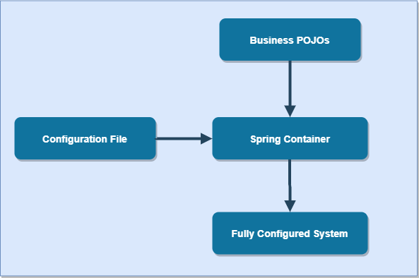
What is IoC container?
In Spring, there is a configuration file where all the classes are kept. Spring has a container called IOC Container where our application is deployed. Container reads the Configuration file and creates the Object of every class inside the container. These objects are nothing but the Spring Beans.

Slide 19
IoC Container
2 Types of Container
BeanFactory
ApplicationContext
a
Interface
c
Interface
b
implements
ClassPathXmlApplicationContext

Slide 20
Back to Practical Demo
Simple Mobile Application Using Spring

Slide 21
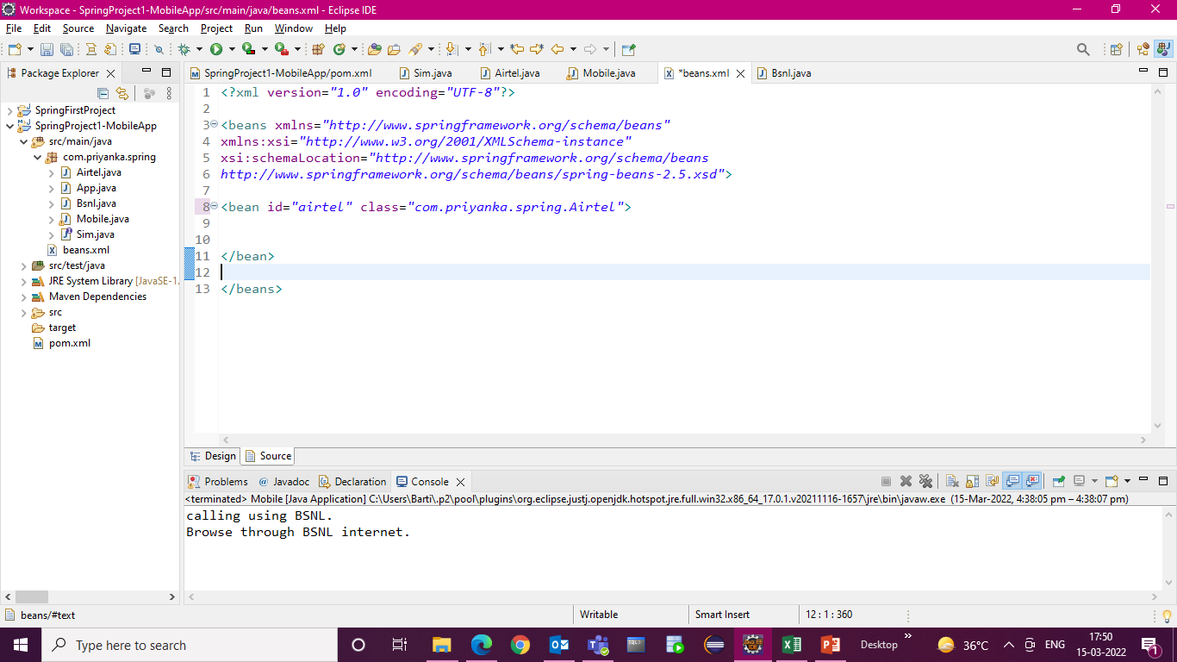
Airtel airtel = new Airtel();
airtel

Slide 22
Spring IoC Container
Since we are done with the first basic program, I hope you have got an idea about Spring Framework. Let’s now discuss on some of the concepts working at the core of Spring Framework. We will begin with IoC container.
So what exactly is an IoC container in Spring? Well, Spring IoC stands for Inversion of Control. It is the heart of the Spring Framework. The important tasks performed by the IoC container are:
Instantiating the bean
Wiring the beans together
Configuring the beans
Managing the bean’s entire life-cycle

Slide 23
Spring IoC Container
The IoC container receives metadata from either an XML file, Java annotations, or Java code and works accordingly. IoC adds the flexibility and control of application, and provides a central place of configuration management for Plain Old Java Objects (POJO) of our application. This diagram represents an abstract view of the working of Spring Framework. It shows how Spring makes use of Java POJO classes and configuration metadata to produce a fully configured and executable system or application.
There are two types of IoC containers:
BeanFactory
ApplicationContext

Slide 24
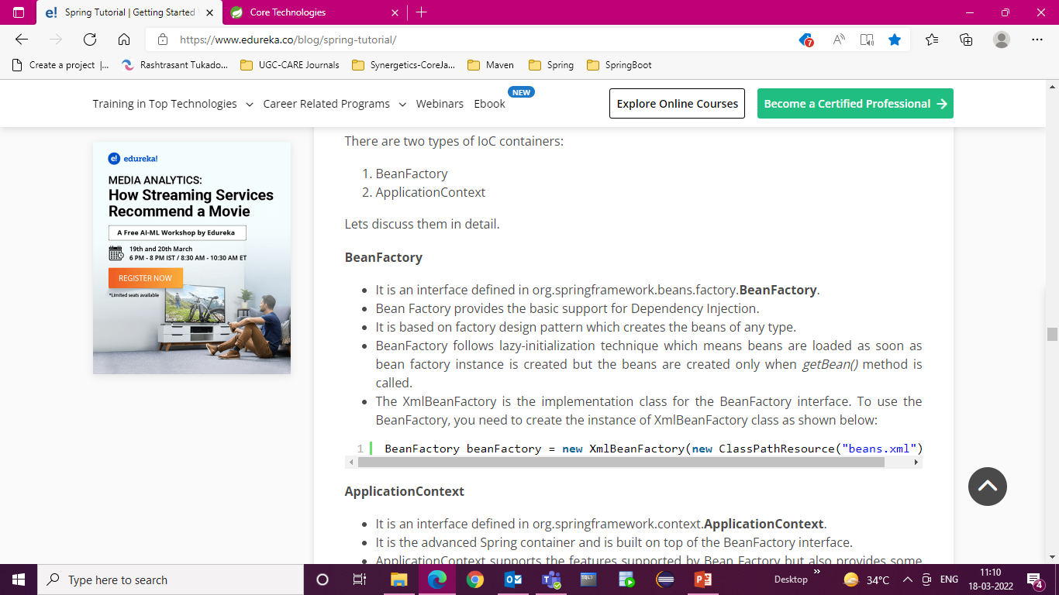
Bean Factory
It is an interface defined in org.springframework.beans.factory.BeanFactory.
Bean Factory provides the basic support for Dependency Injection.
It is based on factory design pattern which creates the beans of any type.
BeanFactory follows lazy-initialization technique which means beans are loaded as soon as bean factory instance is created but the beans are created only when getBean() method is called.
The XmlBeanFactory is the implementation class for the BeanFactory interface. To use the BeanFactory, you need to create the instance of XmlBeanFactory class as shown below:

Slide 25
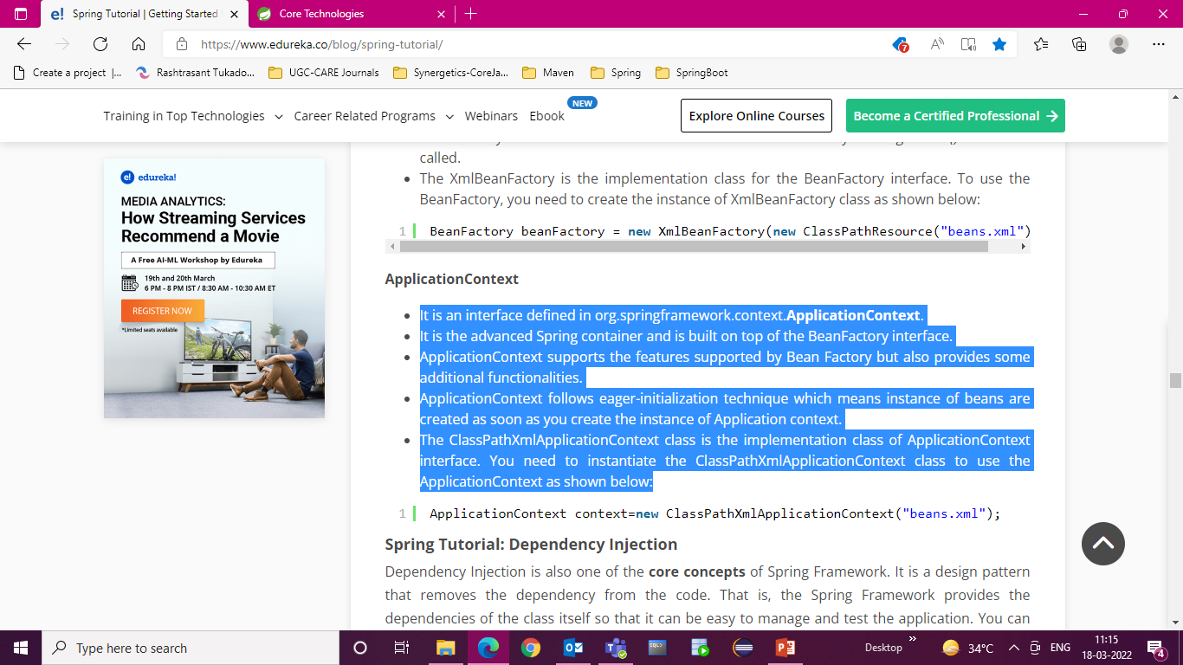
Application Context
It is an interface defined in org.springframework.context.ApplicationContext.
It is the advanced Spring container and is built on top of the BeanFactory interface.
ApplicationContext supports the features supported by Bean Factory but also provides some additional functionalities.
ApplicationContext follows eager-initialization technique which means instance of beans are created as soon as you create the instance of Application context.
The ClassPathXmlApplicationContext class is the implementation class of ApplicationContext interface. You need to instantiate the ClassPathXmlApplicationContext class to use the ApplicationContext as shown below:

Slide 26
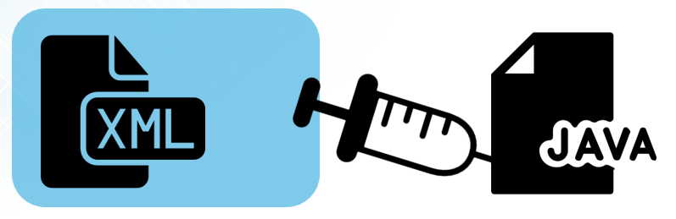
Dependency Injection
Dependency Injection is also one of the core concepts of Spring Framework. It is a design pattern that removes the dependency from the code.
That is, the Spring Framework provides the dependencies of the class itself so that it can be easy to manage and test the application. You can provide information from external source such as XML file. Here, you do not create the objects instead you just define how they should be created and IoC container will create the objects for you.

Slide 27
Dependency Injection
In Spring, dependencies can be injected in two ways:
By constructor
By setter method

Slide 28
Dependency Injection
By Constructor
The <constructor-arg> subelement of <bean> is used for constructor injection.
By default when the Spring container loads the bean, it instantiates the bean with the default constructor. But you can also define a constructor argument in bean definition, using an argument constructor.
By setter method
The <property> subelement of <bean> is used for setter injection.
Setter-based Dependency Injection is accomplished by the container calling setter methods on your beans after invoking a no-argument.

Slide 29
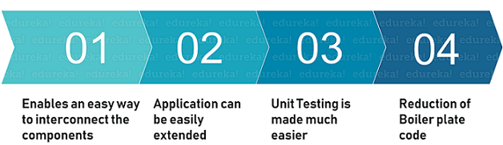
Benefits of DI
1
2
3
4

Slide 30
Back to Practical Demo
Dependency Injection

Slide 31
Advantages of Spring Framework
Spring allows developers to develop enterprise-class applications with the help of POJOs.
Offers templates for Hibernate, JDBC, Hibernate, JPA, etc. to reduce avoid writing lengthy code.
Provides abstraction to Java Enterprise Edition (JEE).
You can organize a spring in a modular fashion. So that if a number of packages and classes are substantial, you only need to about you need and ignore the rest.
It offers declarative support for transactions, formatting, validation, caching, etc.
The application developed using spring is simple as the environment-dependent code is moved into this framework.

Slide 32
Spring Configuration
Till now we have seen XML-based configuration metadata is provided to the IOC Container. But is this the only way? The answer is No. We can provide the configuration metadata in the following two more ways.
Annotation-based Configuration
Java-based Configuration

Slide 33
What is bean Scope?
While creating a bean definition, we can create as many object instances from a single class. Along with this, We can control the scope of the objects created from a particular bean definition. Spring framework provides the following Scopes.
Scope | Description
singleton | It mean a single object. When we set the scope to singleton, the IOC container creates only a single instance of the object defined by the bean definition.
prototype | The prototype scope means every time a new instance of an object is created. The Spring IOC Container will create a new object whenever we will call the getBean() method.
request | It scopes a single bean definition to the HTTP request.
session | It scopes a single bean definition to the HTTP session.
application | It scopes a single bean definition to the ServletContext
websocket | It scopes a single bean definition to the WebSocket.

Slide 34
Back to Practical Demo
BeanScopeDemo

Slide 35
Bean Life Cycle
The Lifecycle of any bean means
how the bean is created,
how it goes from one stage to another,
what are the stages involved from creation to destruction of any object or bean.
In the same way, we have a bean life cycle in the spring framework.
There are some stages involved in the Spring bean life cycle that we will see now.

Slide 36
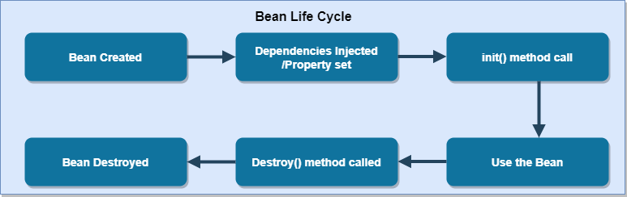
What is Spring Bean Lifecycle?
Beans are nothing but objects in Spring.
IOC container in Spring is responsible for creating objects from the configuration metadata that we supply in a config file.
The container is responsible to manage the overall life cycle of the Spring beans i.e. from the creation of a bean to its destruction.

Slide 37
Back to Practical Demo
BeanLifeCycleDemo

Slide 38
Spring Autowiring : By XML configuration or @Autowired
We declare all the bean dependencies in a config file, the container then creates an object by autowiring the relationship between collaborating beans. This is called Spring bean autowiring.
In this, we don’t need to use <construstor-arg> and <property> element in XML file.
For autowiring w can either set it up by xml configuration file or @Autowired annotation.
Internally, It uses Setter Method or Constructor Injection.
It is used with reference type and not with primitive and String.
Modes of Autowiring
default mode
byName mode
byType mode
constructor mode

Slide 39
Back to Practical Demo
Spring Autowiring Demo

Slide 40
Java Based Configuration
Configuration of Spring Beans is required so that the container can create an object i.e we can implement the Inversion of Control feature of the spring framework. Using XML-based configuration is a good idea, but if you find writing XML files tiresome then Don’t worry, because Spring 3.1 came up with Java-based Configuration.
@Configuration & @Bean
According to the Documented Definition: @Configuration annotation indicates that a class declares one or more @Bean methods and may be processed by the spring container to generate bean definitions and service requests for those beans at runtime.
Instead of writing the bean configuration in the XML file. We will write in a Java class file and the Spring container will take care of creating the object.
@Bean : In the XML file, we have used <bean/> element to declare the bean and now instead of this, we will use @Bean annotation on the method.

Slide 41
Back to Practical Demo
Spring Java Based Configuration Demo

Slide 42
Thank You
Priyanka Sarode

